Slide 1
.Net
WEB ENGINEERING

Slide 2
Week 2 - Day 7

Slide 3

: Basics

Slide 4
Recap Questions
The following questions will be asked to the participants for review:
What is
jQuery Syntax
jQuery Selectors
Manipulating HTML DOM with jQuery

Slide 5
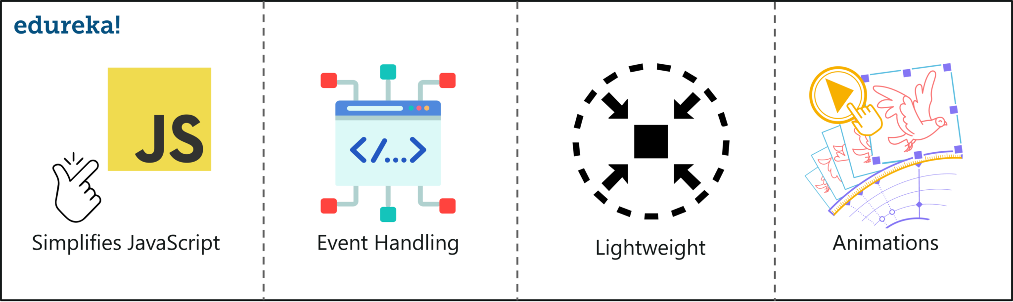
What is jQuery?
Notes:
jQuery is an efficient & fast JavaScript Library created by John Resig in 2006. The motto of jQuery is write less, do more, which is very apt because it’s functionality revolves around simplifying each and every line of code. Here is a list of jQuery key features:

Slide 6

Learning Objectives
By the end of this session, the students will have developed an understanding of:
jQuery Animation
Hide/Show
Fade
Slide
Manipulating CSS with jQuery

Slide 7
jQuery Animation

Slide 8
jQuery Animation
jQuery includes methods which give special effects to the elements on hiding, showing, changing style properties, and fade-in or fade-out operation.
These special effect methods can be useful in building an interactive user interface.
The following table lists jQuery methods for adding special effects to the DOM elements.
Notes:
https://www.tutorialsteacher.com/jquery/jquery-animation

Slide 9
jQuery Methods for Special Effects | Description
animate() | Perform custom animation using element's style properties.
queue() | Show or manipulate the queue of functions to be executed on the specified element.
stop() | Stop currently running animations on the specified element(s).
fadeIn() | Display specified element(s) by fading them to opaque.
fadeOut() | Hides specified element(s) by fading them to transparent.
fadeTo() | Adjust the opacity of the specified element(s)
fadeToggle() | Display or hide the specified element(s) by animating their opacity.
Notes:
https://www.tutorialsteacher.com/jquery/jquery-animation

Slide 10
jQuery Methods for Special Effects | Description
hide() | Hide specified element(s).
show() | Display specified element(s).
toggle() | Display hidden element(s) or hide visible element(s).
slideUp() | Hide specified element(s) with sliding up motion.
slideDown() | Display specified element(s) with sliding down motion.
slideToggle() | Display or hide specified element(s) with sliding motion.
Notes:
https://www.tutorialsteacher.com/jquery/jquery-animation

Slide 11

jQuery animate() Method
The jQuery animate() method is used to create custom animations by changing the CSS numerical properties of a DOM element, for example, width, height, margin, padding, opacity, top, left, etc.
Following is a simple syntax of animate() method:

Slide 12
Some Important points
You can apply any jQuery selector to select any DOM element and then apply jQuery animate() method to animate it. Here is the description of all the parameters which give you a complete control over the animation:
properties − A required parameter which defines the CSS properties to be animated and this is the only mandatory parameter of the call.
speed − An optional string representing one of the three predefined speeds ("slow", "normal", or "fast") or the number of milliseconds to run the animation (e.g. 1000).
callback − An optional parameter which represents a function to be executed whenever the animation completes.

Slide 13
Animate: Pre-Requisites
(a) - The animate() method does not make hidden elements visible as part of the effect. For example, given $(selector).hide().animate({height: "20px"}, 500), the animation will run, but the element will remain hidden.
(b) - To manipulate the position of a DOM element as a part of the animation, first we need to set it's position to relative, fixed, or absolute because by default, all HTML elements have a static position, and they cannot be moved using animate() method.

Slide 14
The animate() method changes existing style properties to the specified properties with motion.
Specify a selector to get the reference of an element to which you want to add animation effect and then call animate() method with JSON object for style properties, speed of animation and other options.

Slide 15
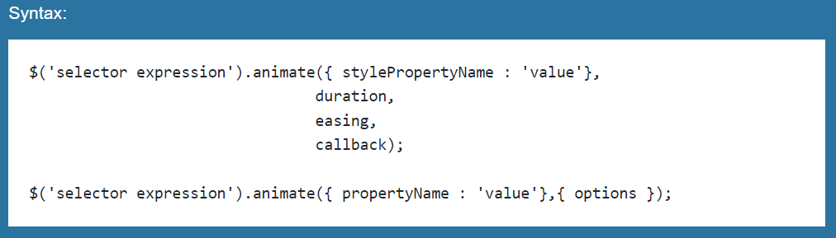
Syntax
Notes:
https://www.tutorialsteacher.com/jquery/jquery-animation

Slide 16
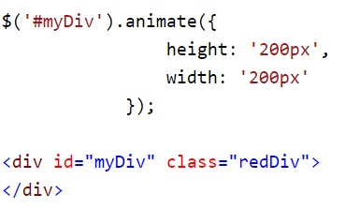
Apply Animation: Example
In the following example, we are changing height and width of the element with animation.
Try out this example on your computers and then check the output here:
Notes:
https://www.tutorialsteacher.com/jquery/jquery-animation

Slide 17
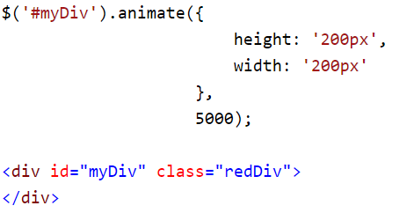
Set Animation Duration
You can apply animation duration in miliseconds as a second parameter of animate() method.
Try out this example on your computers and then check its output here:
Notes:
https://www.tutorialsteacher.com/jquery/jquery-animation

Slide 18
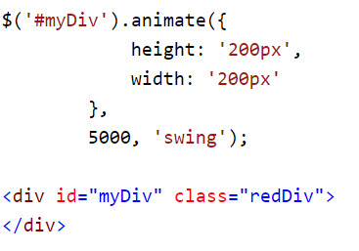
Apply Easing Method
Specify a string parameter indicating which easing function to use for the transition. The jQuery library provides two easing function: linear and swing.
Try out this example on your computers and then check its output here:
Notes:
https://www.tutorialsteacher.com/jquery/jquery-animation

Slide 19
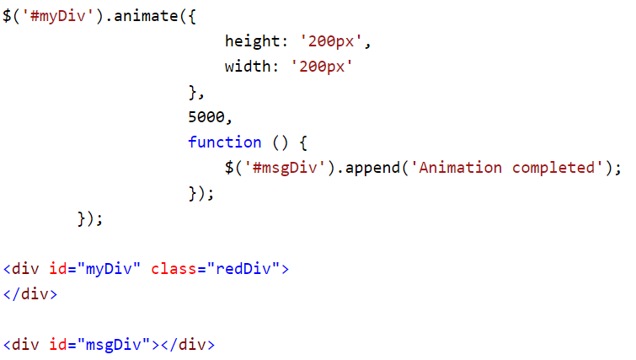
Callback Function on Animation Complete
Specify a callback function to execute when animation is complete.
Try out this example on your computers and then check its output here:
Notes:
https://www.tutorialsteacher.com/jquery/jquery-animation

Slide 20
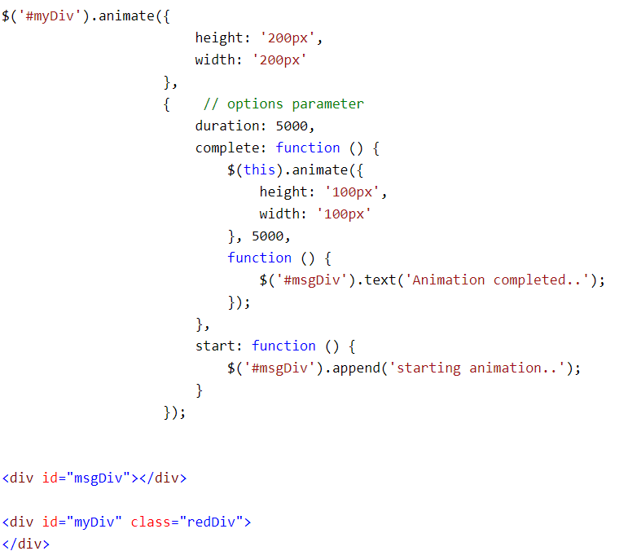
Specify Animation Options
You can specify various options as JSON object. The options include duration, easing, queue, step, progress, complete, start, done and always. Visit api.jquery.com for more information.
Try out this example on your computers and then check its output here:
Notes:
https://www.tutorialsteacher.com/jquery/jquery-animation

Slide 21
fadeIn() / fadeOut()

Slide 22
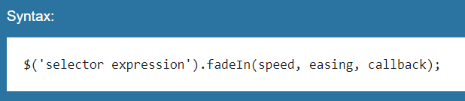
jQuery fadeIn() Method
The jQuery fadeIn() method displays specified element(s) by fading them to opaque.

Slide 23
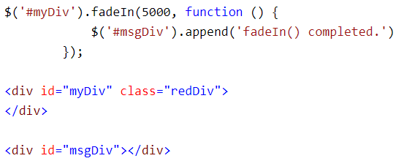
jQuery fadeIn() Method
Try out this example on your computers and then check its output here:

Slide 24
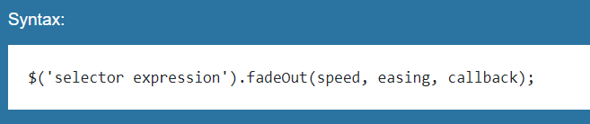
jQuery fadeOut() Method
The jQuery fadeOut() method hides specified element(s) by fading them to transparent.

Slide 25
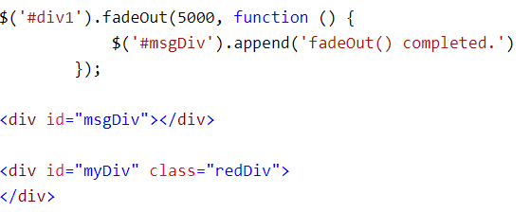
jQuery fadeOut() Method
Try out this example on your computers and then check its output here:

Slide 26
Hide() / Show()

Slide 27
jQuery show() and hide() Methods
You can show and hide HTML elements using the jQuery show() and hide() methods.
The hide() method simply sets the inline style display: none for the selected elements.
Conversely, the show() method restores the display properties of the matched set of elements to whatever they initially were—typically block, inline, or inline-block—before the inline style display: none was applied to them. Here's is an example.

Slide 28
jQuery show() and hide() Methods
Durations can be specified either using one of the predefined string 'slow' or 'fast', or in a number of milliseconds, for greater precision; higher values indicate slower animations.

Slide 29
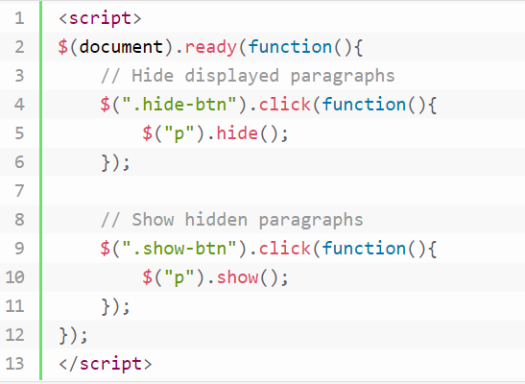
Example 1
Practice writing the code on your computer.
Then, check the output here

Slide 30
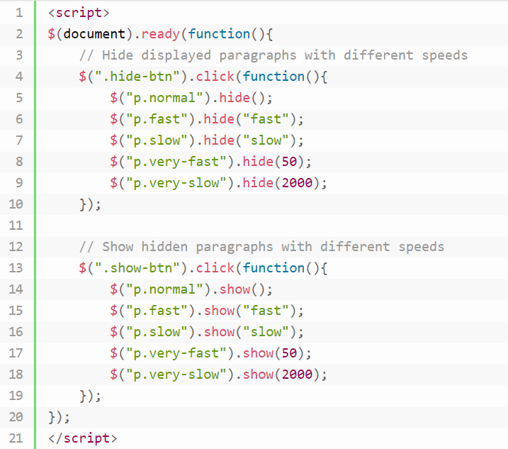
Example 2
Note: The speed or duration string 'fast' indicates the durations of 200 milliseconds, while the string 'slow' indicates the durations of 600 milliseconds.
Try out this example on your computers and Check the output here
Notes:
https://www.tutorialrepublic.com/jquery-tutorial/jquery-show-and-hide-effects.php

Slide 31
Slide up/down/toggle

Slide 32
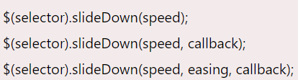
slideDown()
Syntax

Slide 33
slideDown()
speed: It specifies the speed of the delay. Its possible values are slow, fast and milliseconds.
easing: It specifies the easing function to be used for transition.
callback: It is also an optional parameter. It specifies the function to be called after completion of slideDown() effect.
Let's take an example to demonstrate jQuery slideDown() effect.

Slide 34
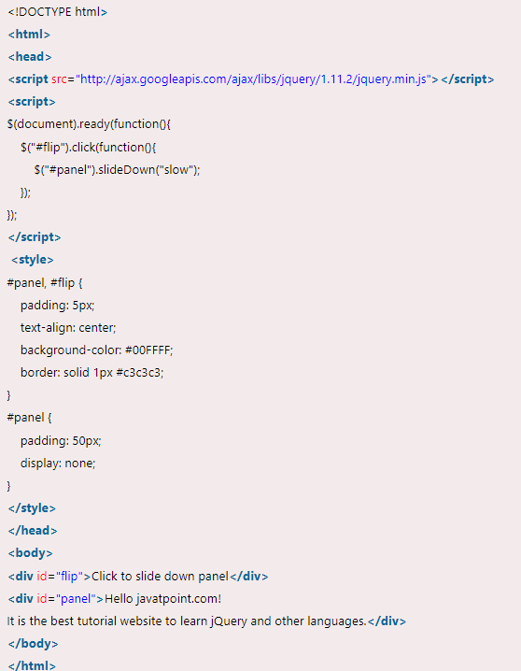
slideDown()
Example https://www.javatpoint.com/jquery-slidedown
Try out this example on your computers and then check its output here:
Notes:
https://www.javatpoint.com/jquery-slidedown

Slide 35
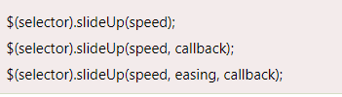
slideUp()
Syntax

Slide 36
slideUp()
speed: It specifies the speed of the delay. It's possible values are slow, fast and milliseconds.
easing: It specifies the easing function to be used for transition.
callback: It is also an optional parameter. It specifies the function to be called after completion of slideUp() effect.
Let's take an example to demonstrate jQuery slideUp() effect.

Slide 37
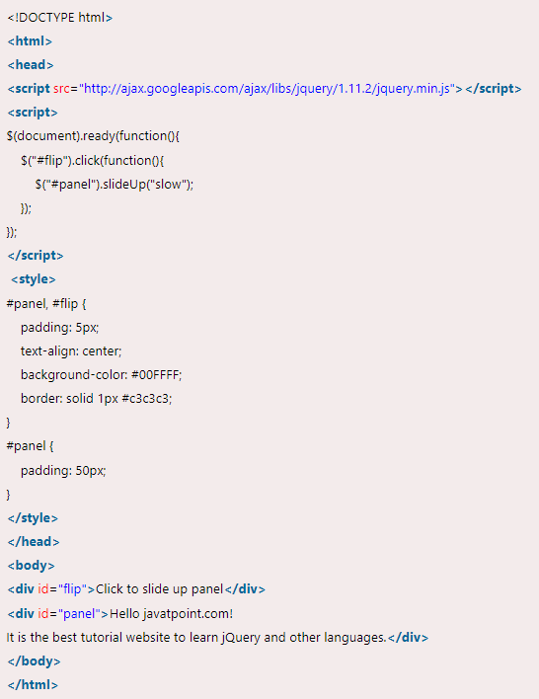
slideUp()
Example https://www.javatpoint.com/jquery-slideup
Try out this example on your computers and then check its output here:
Notes:
https://www.javatpoint.com/jquery-slidedown

Slide 38

slideToggle()
Syntax

Slide 39
slideToggle()
speed: It specifies the speed of the delay. Its possible vales are slow, fast and milliseconds.
easing: It specifies the easing function to be used for transition.
callback: It is also an optional parameter. It specifies the function to be called after completion of slideToggle() effect.
Let's take an example to demonstrate jQuery slideToggle() effect.

Slide 40

slideToggle()
Example https://www.javatpoint.com/jquery-slidetoggle
Try out this example on your computers and then check its output here:
Notes:
https://www.javatpoint.com/jquery-slidedown

Slide 41
CSS Manipulation using jQuery
Notes:
https://www.tutorialsteacher.com/jquery/jquery-css-manipulation

Slide 42
CSS Manipulation
The jQuery library includes various methods to manipulate style properties and CSS class of DOM element(s).
The following table lists jQuery methods for styling and css manipulation.
jQuery Methods | Description
css() | Get or set style properties to the specified element(s).
addClass() | Add one or more class to the specified element(s).
hasClass() | Determine whether any of the specified elements are assigned the given CSS class.
removeClass() | Remove a single class, multiple classes, or all classes from the specified element(s).
toggleClass() | Toggles between adding/removing classes to the specified elements

Slide 43
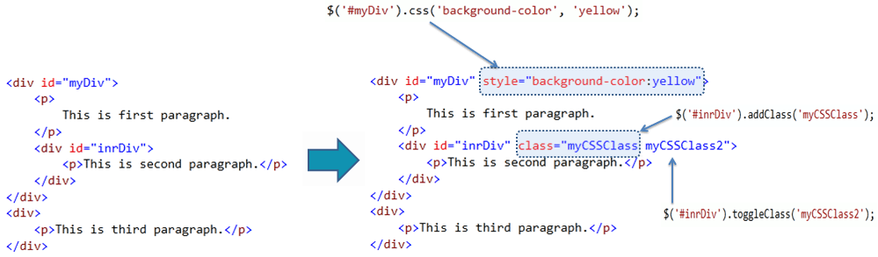
CSS Manipulation
The following figure shows how jQuery methods changes style and css class of the DOM elements.
Notes:
https://www.tutorialsteacher.com/jquery/jquery-css-manipulation

Slide 44
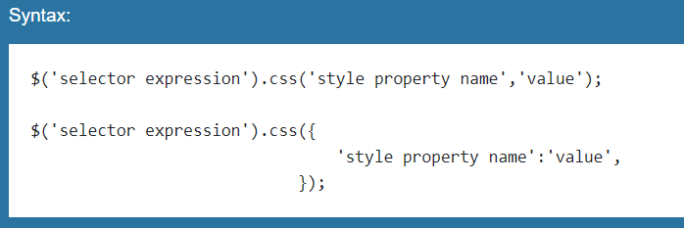
jQuery css() Method
The jQuery css() method gets or sets style properties to the specified element(s).
Specify a selector to get the reference of an elements to which you want to set the style property and then call css() method with style property name and value parameter. You can also set multiple style properties by passing JSON object with 'style property name':'value'.
Notes:
https://www.tutorialsteacher.com/jquery/jquery-css-manipulation

Slide 45
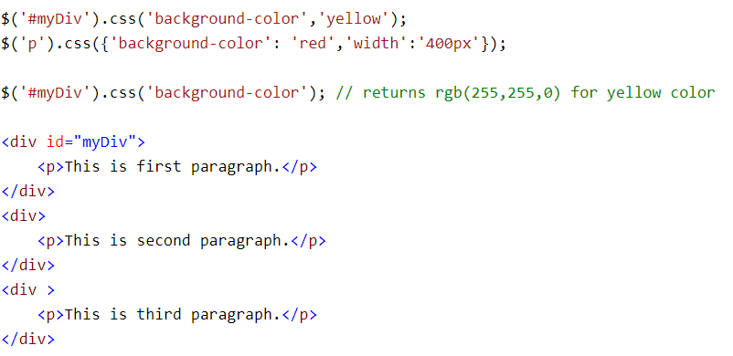
css() Method: Example
Try out this example on your computers and then check its output here:
Notes:
https://www.tutorialsteacher.com/jquery/jquery-css-manipulation

Slide 46
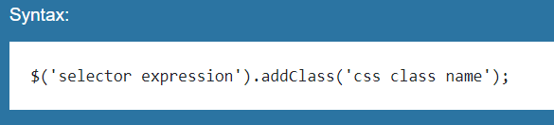
jQuery addClass() method
The jQuery addClass() method adds single or multiple css class to the specified element(s).
First specify a selector to get the reference of an elements to which you want to set the css property and then call addClass() method with one or multiple class names as a string parameter. Multiple class names must be separated by space.
Notes:
https://www.tutorialsteacher.com/jquery/jquery-css-manipulation

Slide 47
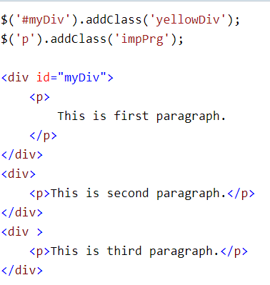
addClass() method: Example
Try out this example on your computers and then check its output here:
Notes:
https://www.tutorialsteacher.com/jquery/jquery-css-manipulation

Slide 48
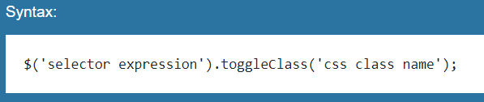
jQuery toggleClass() Method
The jQuery toggleClass() method toggles between adding/removing classes to the specified elements.
Specify a selector to get the reference of an elements to which you want to toggle css classes and then call toggleClass() method with css class name as a string parameter.
Notes:
https://www.tutorialsteacher.com/jquery/jquery-css-manipulation

Slide 49
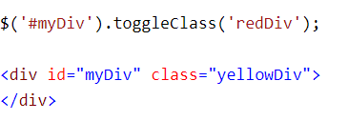
toggleClass() Method: Example
Try out this example on your computers and then check its output here:
Notes:
https://www.tutorialsteacher.com/jquery/jquery-css-manipulation

Slide 50

Important Points
The jQuery CSS methods allow you to manipulate CSS class or style properties of DOM elements.
Use the selector to get the reference of an element(s) and then call jQuery css methods to edit it.
Important DOM manipulation methods: css(), addClass(), hasClass(), removeClass(), toggleClass() etc.
Notes:
https://www.tutorialsteacher.com/jquery/jquery-css-manipulation

Slide 51

Homework
Students will practice exercises of the topics covered today from this link:
JQuery DOM Practice Exercises
&
https://api.jquery.com/animate/

Slide 52

Learning Objectives
By the end of this session, the students have practised
Hide/Show
Fade
Slide
jQuery Animation
Manipulating CSS with jQuery

Slide 53
Conclusion & Q/A
See you tomorrow!

